Slide 1
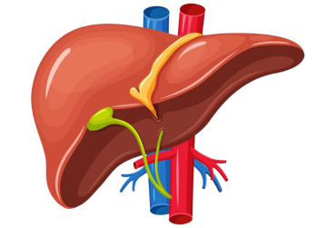


Liver Transplantation Basics
Mohammad Almeqdadi, MD
Assistant Professor of Medicine and Surgery
Transplant Hepatology and Gastroenterology

Slide 2
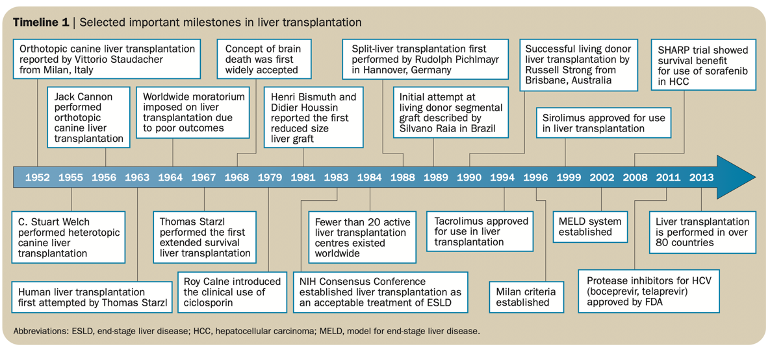
Zarrinpar A, Busuttil RW. Liver transplantation: past, present and future. Nat Rev Gastroenterol Hepatol. 2013 Jul;10(7):434-40

Slide 3
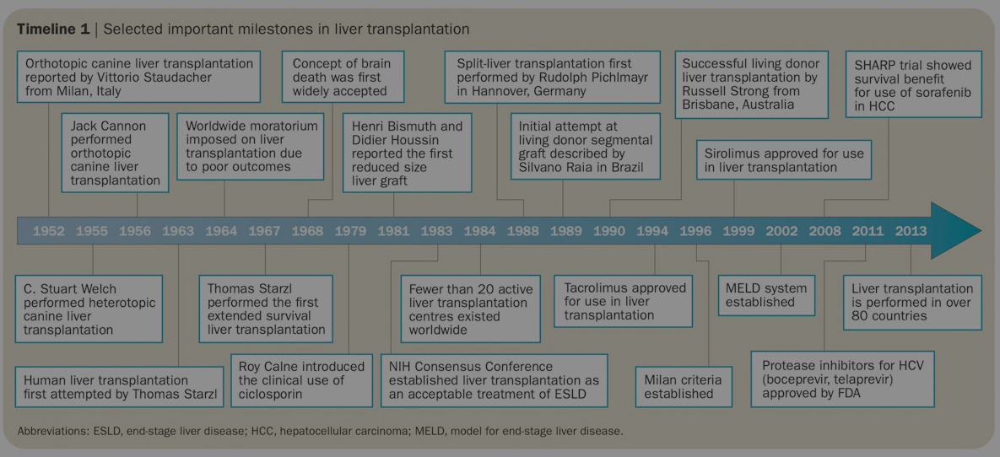
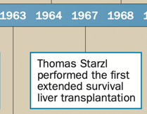

Zarrinpar A, Busuttil RW. Liver transplantation: past, present and future. Nat Rev Gastroenterol Hepatol. 2013 Jul;10(7):434-40

Slide 4
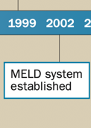
Zarrinpar A, Busuttil RW. Liver transplantation: past, present and future. Nat Rev Gastroenterol Hepatol. 2013 Jul;10(7):434-40

Slide 5
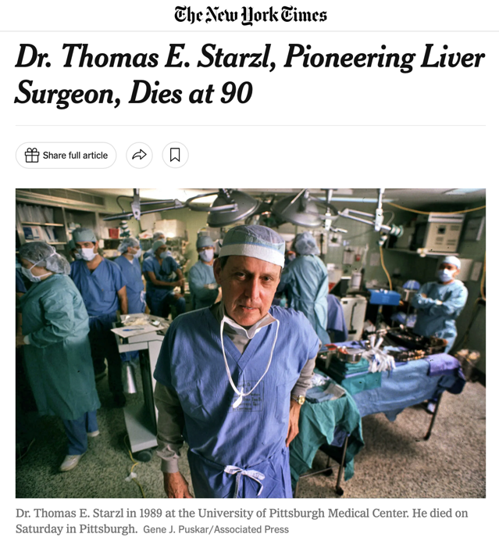
March 5, 2017

Slide 6
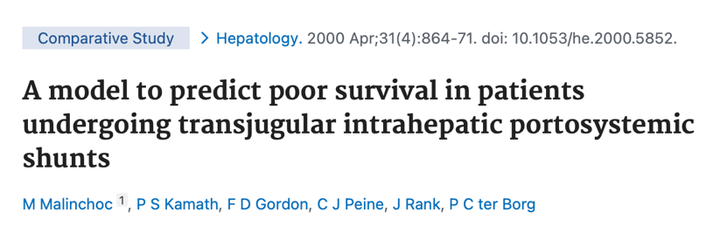
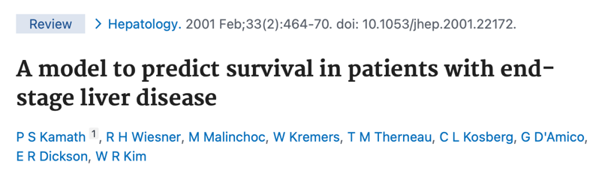

Slide 7
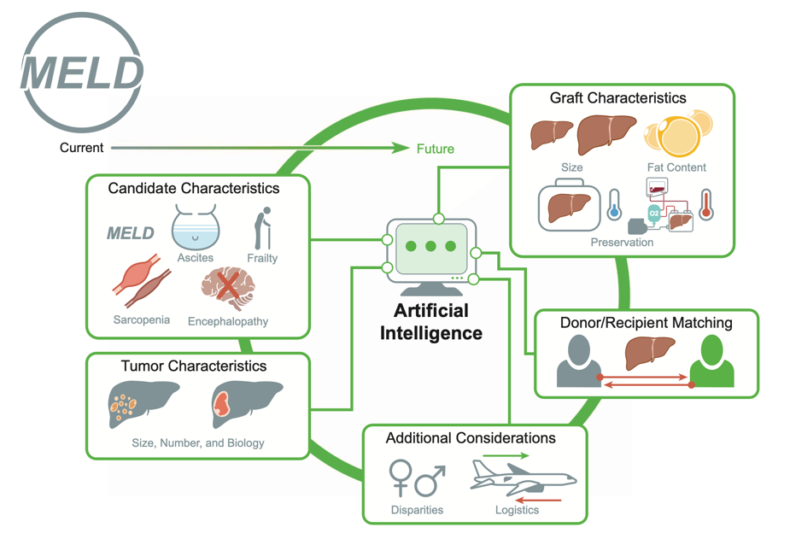
Feng S, Roll GR, Rouhani FJ, Sanchez Fueyo A. The future of liver transplantation. Hepatology. 2024 Sep 1;80(3):674-697

Slide 8
Indications and Contraindications
Liver Transplant

Slide 9
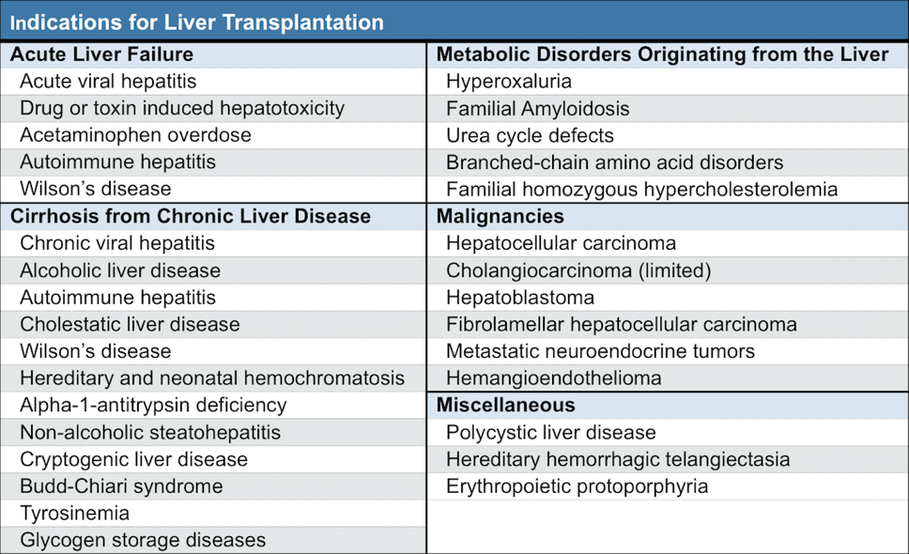
O'Leary JG, Lepe R, Davis GL. Indications for liver transplantation. Gastroenterology. 2008 May;134(6):1764-76

Slide 10
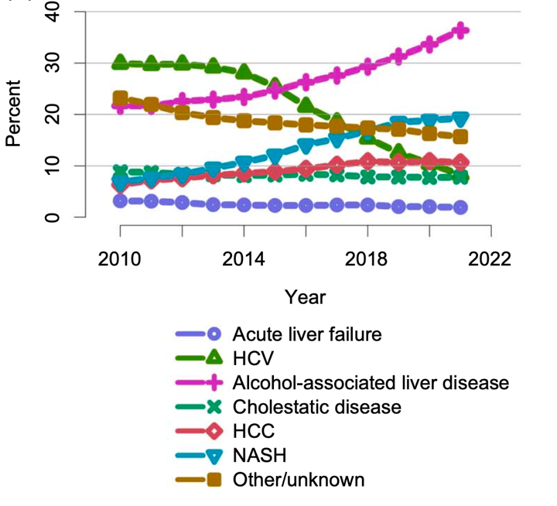

Slide 11
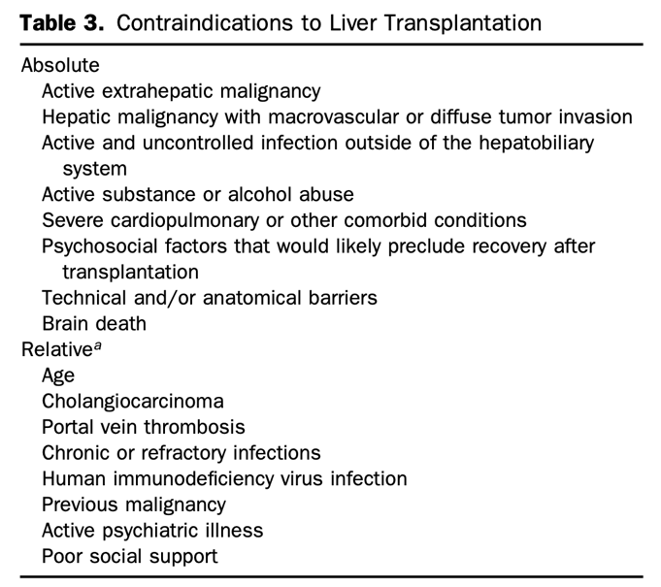
*
O'Leary JG, Lepe R, Davis GL. Indications for liver transplantation. Gastroenterology. 2008 May;134(6):1764-76

Slide 12
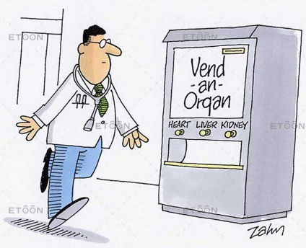
Is liver transplant worth all the trouble?

Slide 13
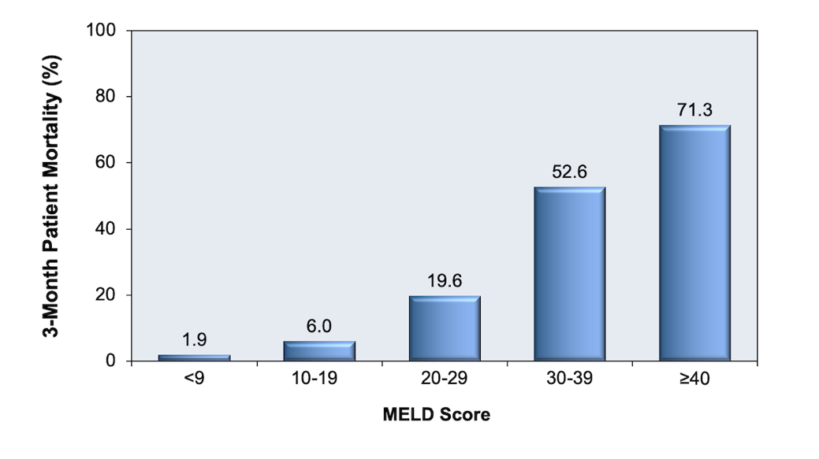
Gastroenterology. 2003 Jan;124(1):91-6

Slide 14
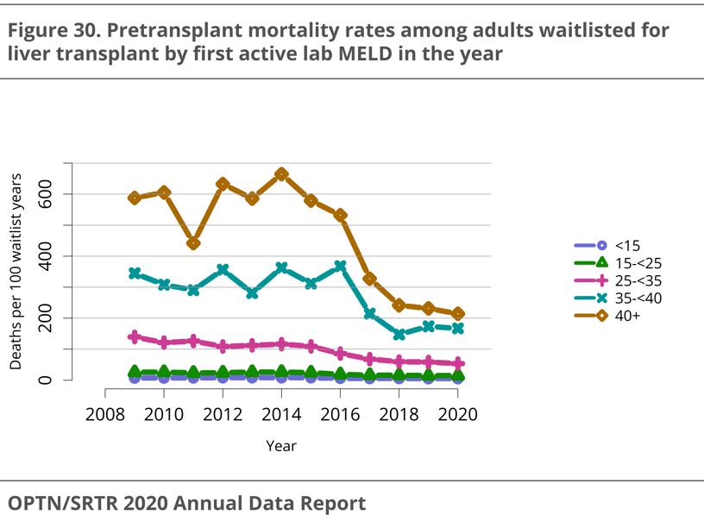

Slide 15
How come mortality dropped here?

Slide 16
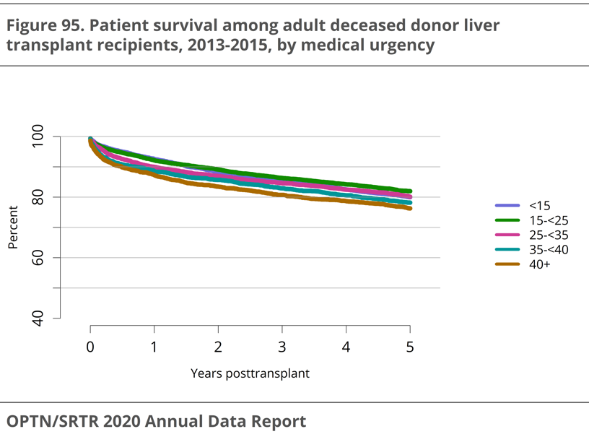

Slide 17
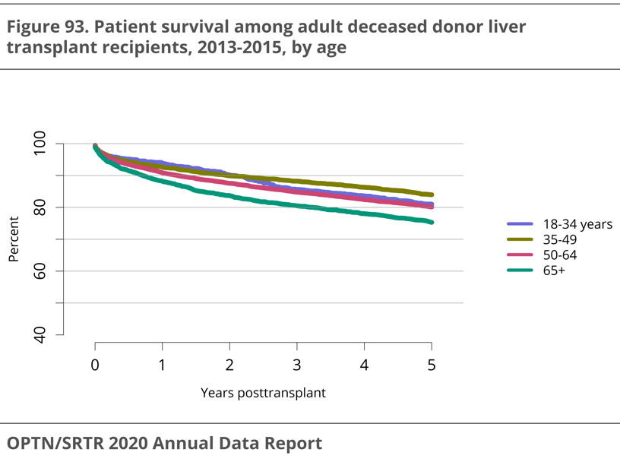

Slide 18
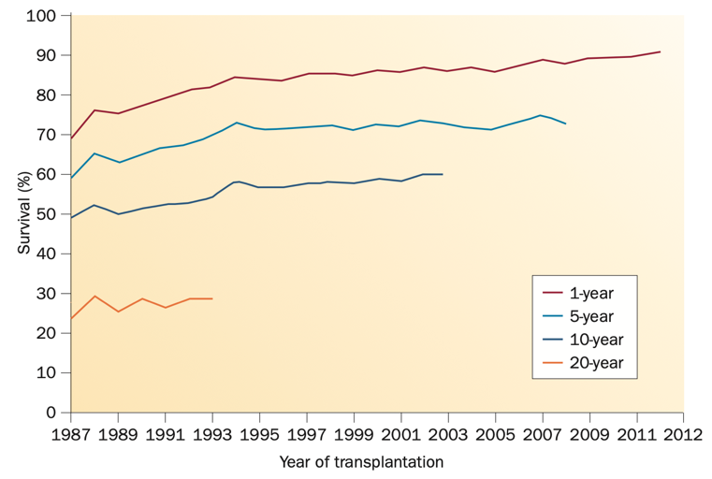
Overall survival after adult liver transplantation
Watt, K. D. Nat. Rev. Gastroenterol. Hepatol. 12, 639–648 (2015)

Slide 19
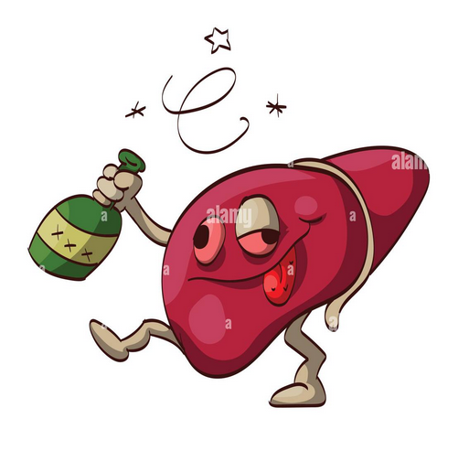
How does a patient end up with a liver transplant?
Timeline

Slide 20
Whom to refer?
Any decompensated cirrhotic
  Ascites, variceal bleed, HCC, hepatic encephalopathy etc.
Compensated cirrhotic with MELD 3.0 >= 15 (persistently)
Patient should be agreeable!
No obvious absolute contraindications (for example EF = 30%)

Slide 21
Why MELD of 15 Became Dogma?
Original UNOS Era Analysis
The "MELD 15" rule was set by original analyses showing that patients transplanted with MELD < 15 did worse than similar patients who remained on the waitlist.
  MELD 6–11: Post-LT mortality was significantly higher.
  MELD 12–14: Post-LT mortality was still higher.
Conclusion: Survival benefit was determined to start only at a MELD score of 15–18.
Subsequent Analysis & Policy
A follow-up decision analysis in 2009 reached the same practical conclusion: LT with MELD ≤ 14 usually does not provide a survival benefit.
  This cemented "15" as the threshold for transplant benefit.
  Subsequent reviews of MELD-based allocation continued to state that DDLT at MELD < 15 is harmful or, at best, neutral.
Conclusion: This is why "15" remains the widely quoted threshold for DDLT benefit.
Am J Transplant. 2005 Feb;5(2):307-13.
Liver Transpl. 2009 Feb;15(2):242-54.

Slide 22
Benefit below MELD 15?

Slide 23
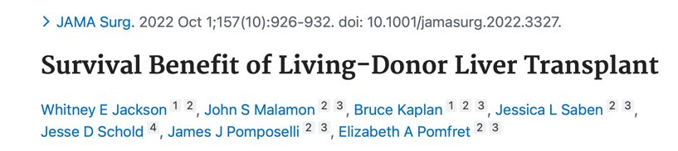
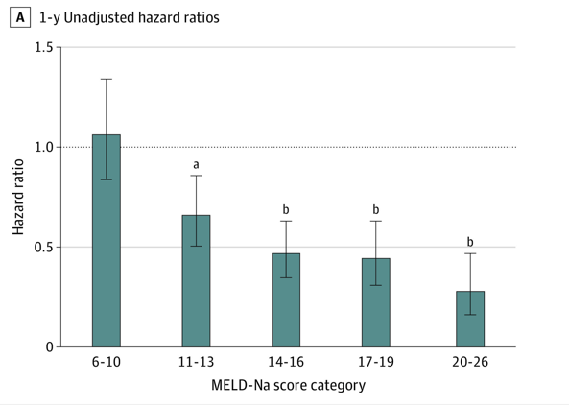
One-year mortality of LDLT vs remaining on the list

Slide 24
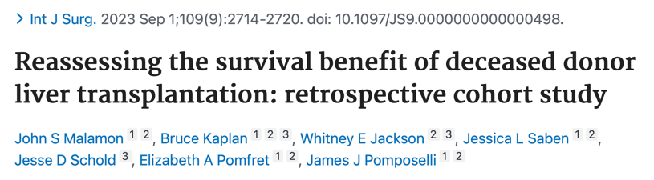
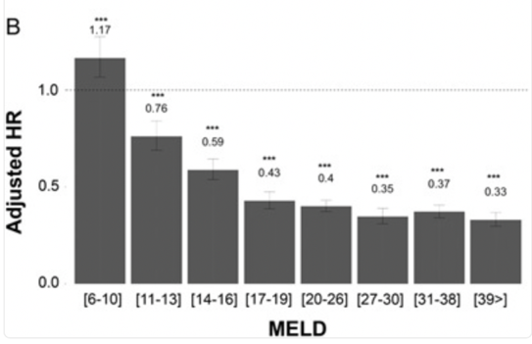
One-year mortality of DDLT vs remaining on the list

Slide 25




The High Burden of Mortality in Low MELD Patients with Cirrhosis on the Wait List
National Scientific Registry of Transplant Recipients Database
One-Year Waitlist Mortality
Discriminative ability of MELD over Time
Findings
 | Mortality 0-1.5 months | Mortality 1.5-3 months | Mortality 3-6 months | Mortality6-9 months | Mortality 9-12 months
6-14 | 1.9 | 2.1 | 3.6 | 3.8 | 3.5
39+ | 32 | 21 | 9.8 | 6.3 | 3.9
p-value | <0.05 | <0.05 | <0.05 | <0.05 | >0.05
c-statistic | 0.83 | 0.82 | 0.77 | 0.70 | 0.64
89,085 patients listed for liver transplant
Case-Control Study
examining waitlist mortality and accuracy of MELD over time
Fifteen percent of candidates with MELD 3.0 scores of 14 or below, who do not decompensate further, die within a year of listing.
Conclusion: Low MELD patients represent a significant mortality burden of all patients waitlisted for transplant with cirrhosis. MELD loses its discriminative ability over time. These two issues will need to be addressed to accurately categorize mortality risk for all patients on the waitlist.
Whitney E. Jackson, MD; Carlos Goncalves, PhD; James J. Pomposelli, MD, PhD; John S. Malamon, PhD; Bruce Kaplan, MD. Transplantation. 2025.
@TransplantJrnl Published by Wolters Kluwer. Please refer to this article online at
journals.lww.com/transplantjournal for full copyright information.

Slide 26
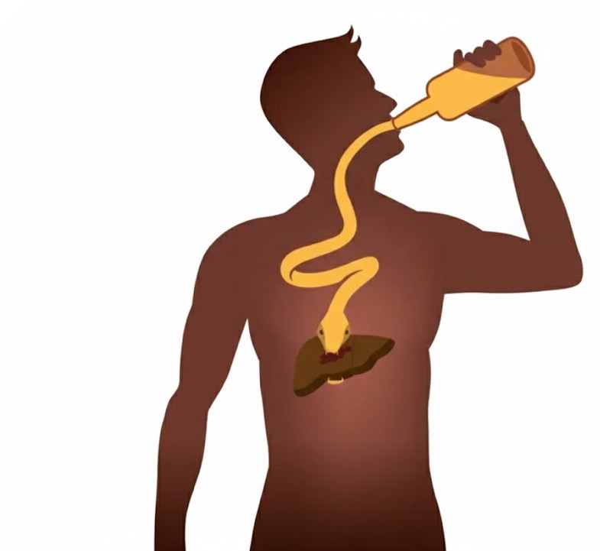
Early Liver Transplantation for Severe Alcoholic Hepatitis

Slide 27
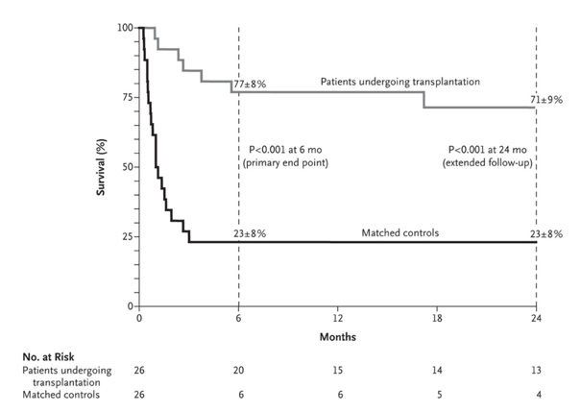
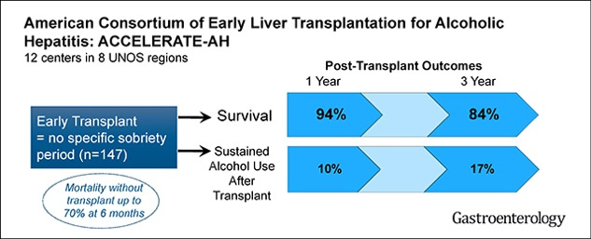
A multicenter study comparing 26 transplanted patients with matched controls.
  LT performed at a median of 13 days.
  6-month survival: 77% (LT) vs. 23% (Controls).
A US cohort study focusing on strict psychosocial selection.
  1-year survival: 94%
  3-year survival: 84%
  Harmful drinking recurrence was 10-25%, with severe relapse being lower.
N Engl J Med. 2011 Nov 10;365(19):1790-800
Gastroenterology. 2018 Aug;155(2):422-430.e1

Slide 28
Early Liver Transplantation for Severe Alcoholic Hepatitis
6-month rule? Not anymore.
We are transplanting patients whose last drink was same day of admission.
Selection is the most important part
Protocolized psychosocial assessment prior to full transplant evaluation
Good outcomes (data to come soon)

Slide 29
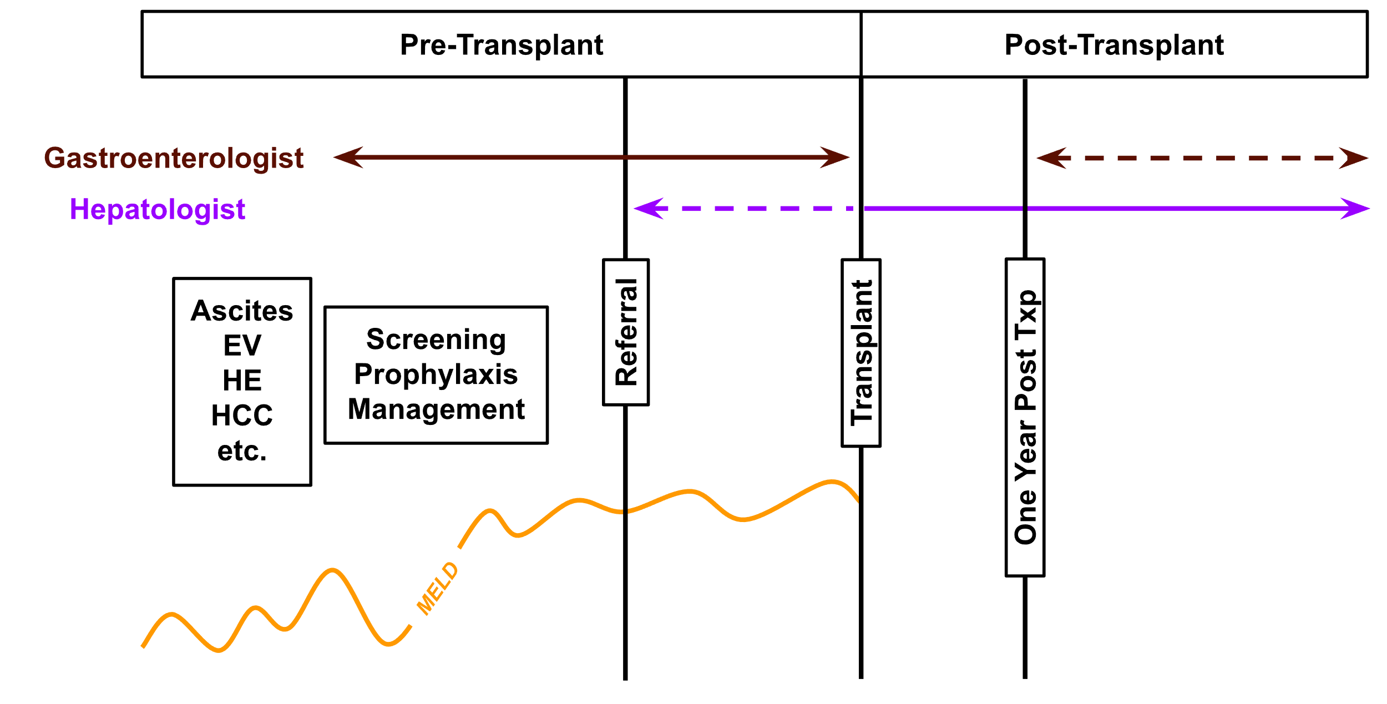

Slide 30
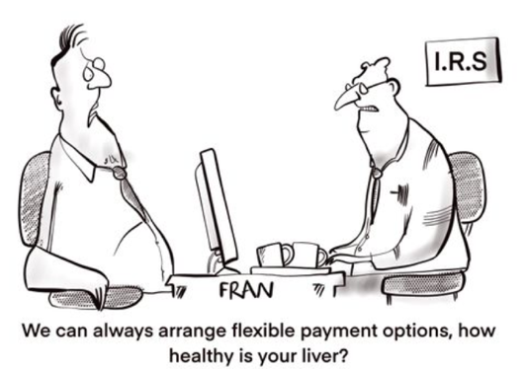
Transplant Evaluation Process
Recipient (patient) evaluation

Slide 31
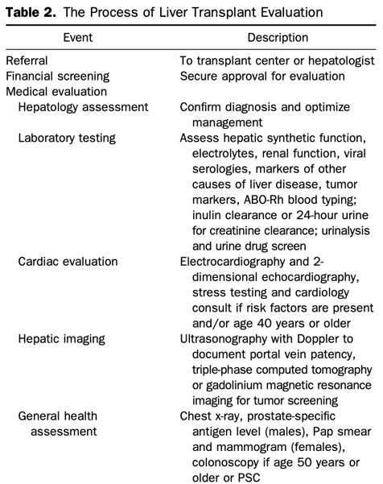

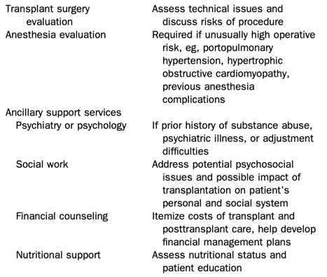
O'Leary JG, Lepe R, Davis GL. Indications for liver transplantation. Gastroenterology. 2008 May;134(6):1764-76

Slide 32
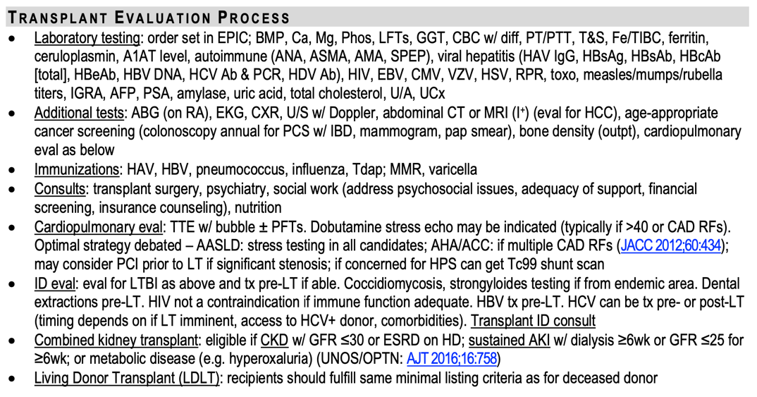
28th Edition of the MGH Department of Medicine Housestaff Manual 2022-2023

Slide 33
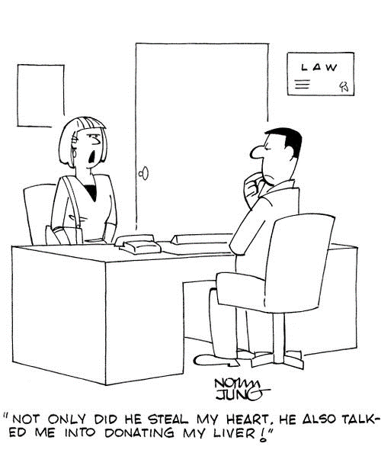
How do we match donors and recipients?

Slide 34
Donor Selection
Which of the following are required for matching liver donors to recipients?
ABO compatibility
Rh antigen compatibility
HLA typing compatibility > 20%
Size Compatibility

Slide 35
Donor Selection
Which of the following are required for matching liver donors to recipients?
ABO compatibility -> preferred, but not required
Rh antigen compatibility -> not required
HLA typing compatibility > 20% -> not required
Size Compatibility -> MOST IMPORTANT

Slide 36
Transplant Shop Talk
  Expanded donor criteria (sometimes called marginal livers)
    Donor over 60 years old.
    Donor over 50 years old with two of the following:
      HTN
      Creatinine > 1.5
      Death from stroke
  Hepatitis C positive livers
  Hepatitis B cAb+ livers
  Hepatitis B NAT+ livers
Patients who agree to receive livers from the above criteria will have access to a wider pool of livers

Slide 37
Transplant Shop Talk
  Expanded donor criteria (sometimes called marginal livers)
    Donor over 60 years old.
    Donor over 50 years old with two of the following:
      HTN
      Creatinine > 1.5
      Death from stroke
  Hepatitis C positive livers
  Hepatitis B cAb+ livers
  Hepatitis B NAT+ livers
Patients who agree to receive livers from the above criteria will have access to a wider pool of livers
OLD CONCEPT
Good Livers with
Bad Reputation!

Slide 38
MELD Exceptions Points
Sometimes MELD score does not reflect the severity of liver disease and the impact on patient’s quality of life and survival
As such, typical exception point system exists to get the patient to a higher status while listed

Slide 39
Standard MELD Exception Points
Hepatopulmonary Syndrome
  RA ABG < 60 mmHg AND echo w/ late bubbles
Portopulmonary Hypertension
  MPAP > 35 + PVR > 240 AND MPAP < 35 post Rx
HCC
  Within Milan criteria (or downstaged)
  AFP < 1000
  ONE LESION between 2-5 cm
  TWO/THREE LESIONS EACH between 1-3 cm
Cholangiocarcinoma
  Hilar mass < 3 cm
  CA19-9>100

Slide 40
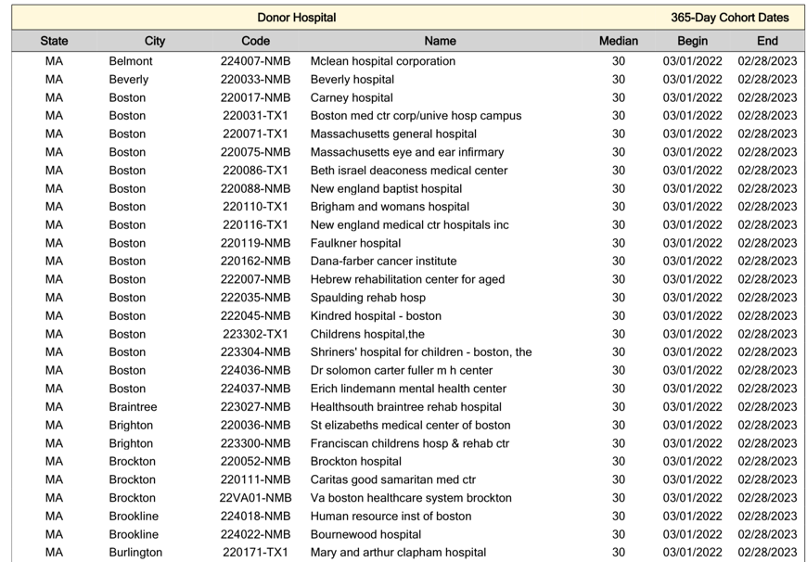
Median MELD At Transplant (MMaT)

Slide 41
How do we use MMaT?
Once patient qualifies for standard exception, most (adult) patients get a MELD score equal to MMaT at donor hospital minus 3 (MMaT -3)

Slide 42
So how do we allocate the deceased donor livers?
“we” is UNOS currently

Slide 43
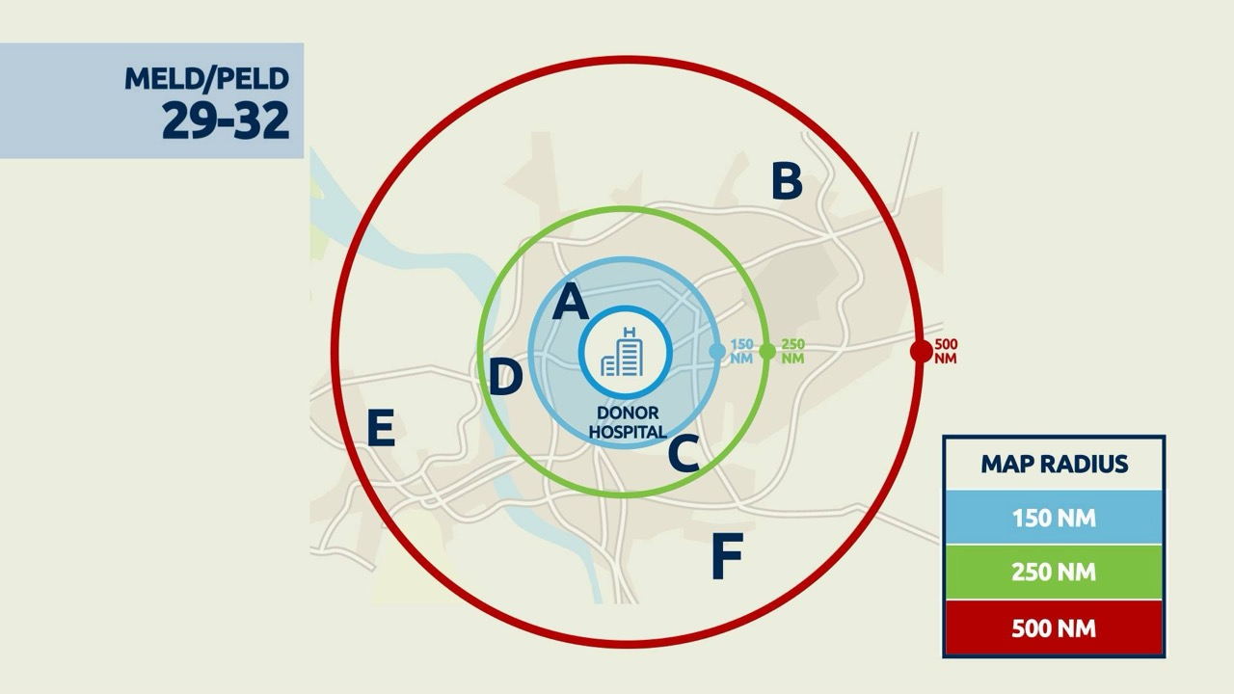

Slide 44


Slide 45
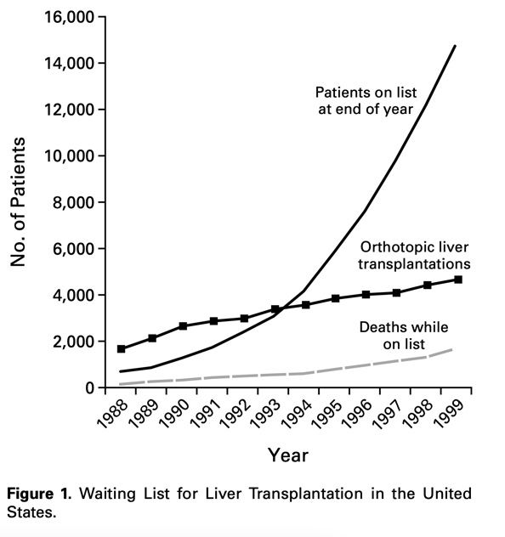
N Engl J Med. 2002 Apr 4;346(14):1074-82

Slide 46
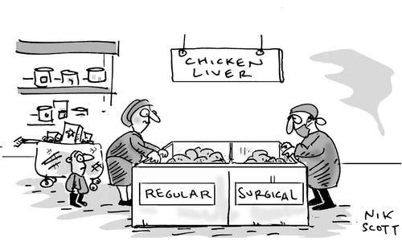
Types of Liver Donors

Slide 47
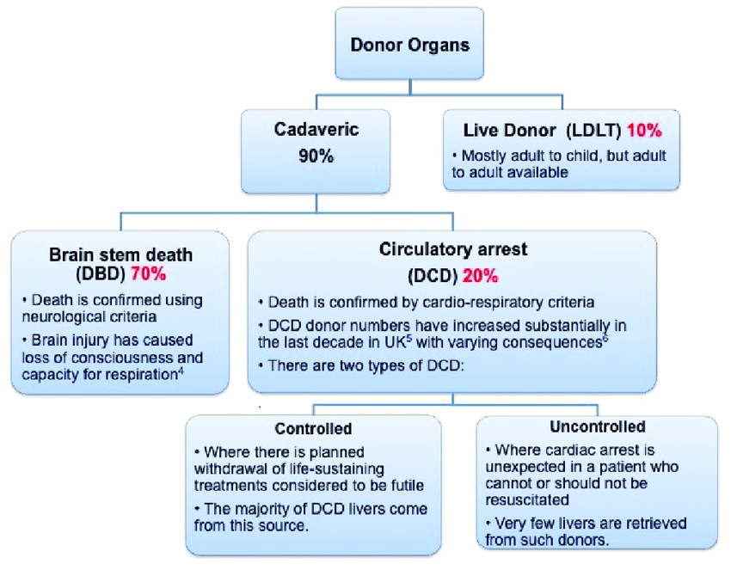
Gastroenterol. 2020 Feb 25;11(5):385-396

Slide 48
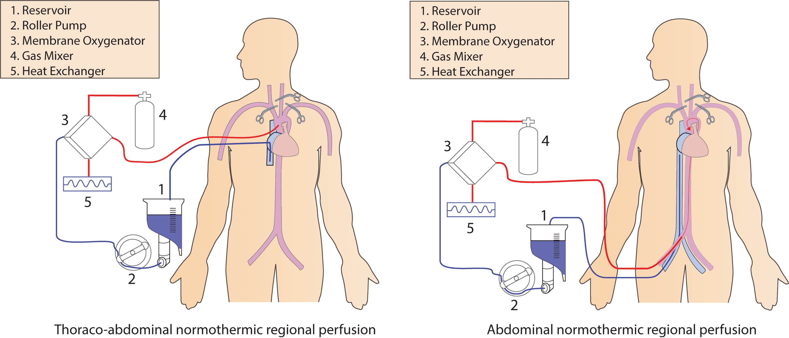
Cureus. 2022 Jun 29;14(6):e26437

Slide 49
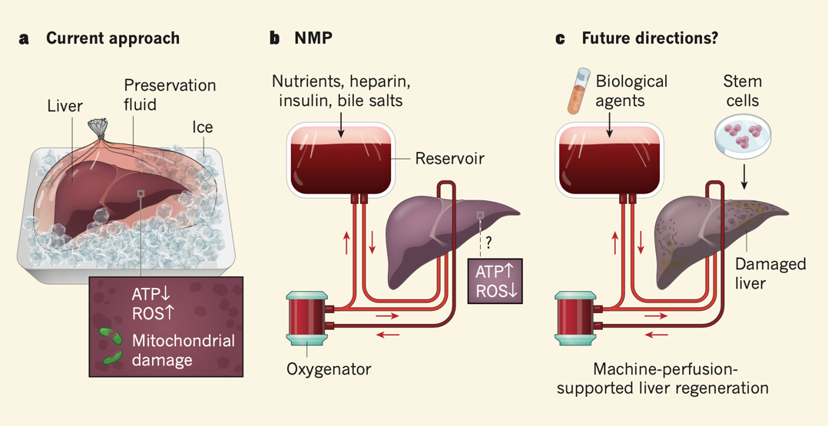
Schneeberger S. Life of a liver awaiting transplantation. Nature. 2018 May;557(7703):40-41

Slide 50
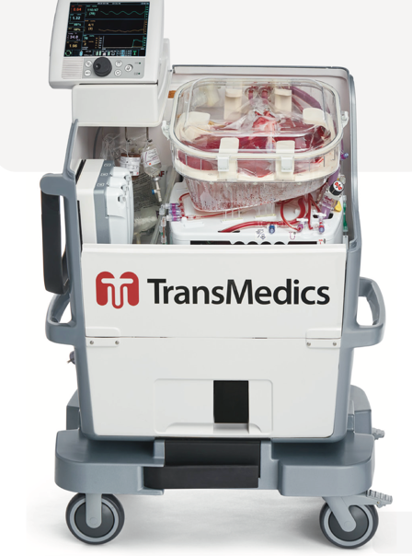
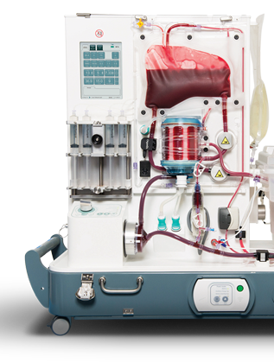
TransMedics and Organox Normothermic Machine Perfusion Machines

Slide 51
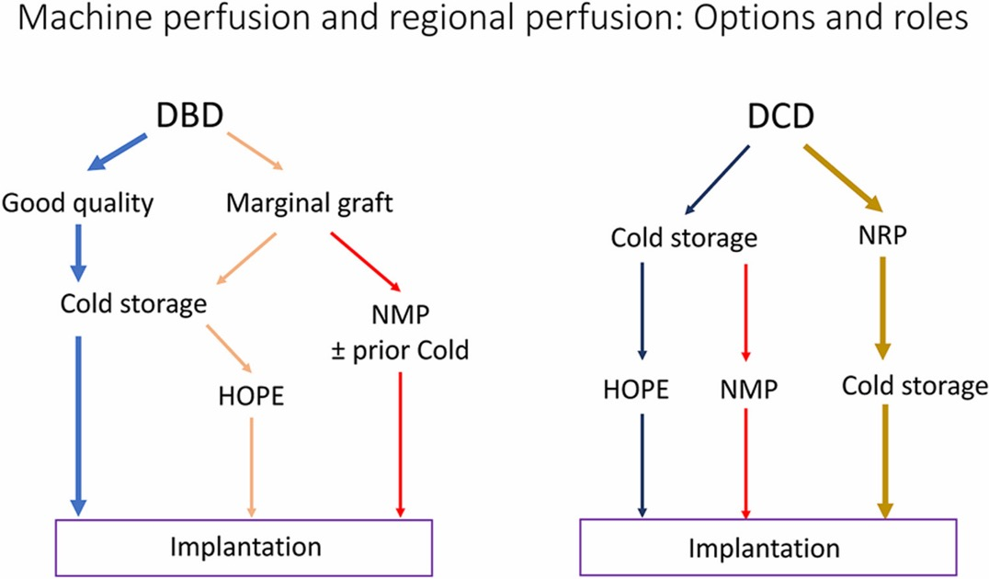
J Clin Exp Hepatol. 2024 Mar-Apr;14(2):101309

Slide 52
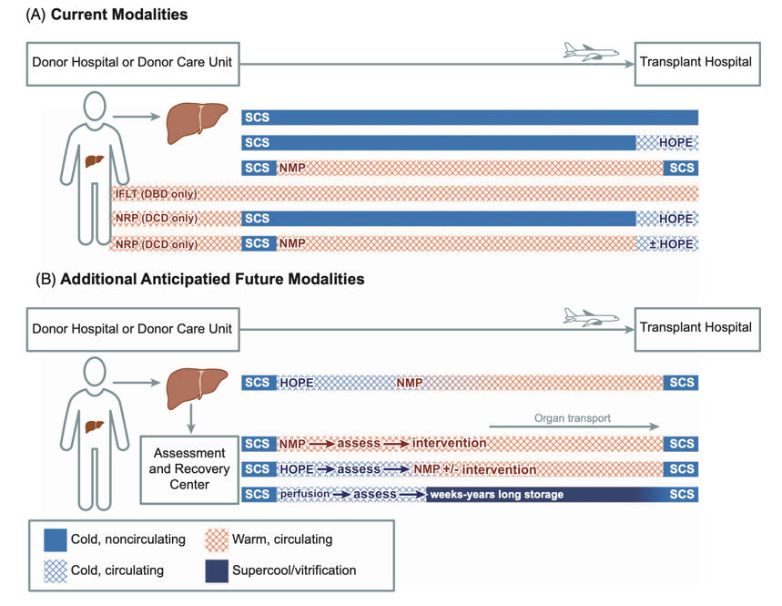
Feng S, Roll GR, Rouhani FJ, Sanchez Fueyo A. The future of liver transplantation. Hepatology. 2024 Sep 1;80(3):674-697

Slide 53
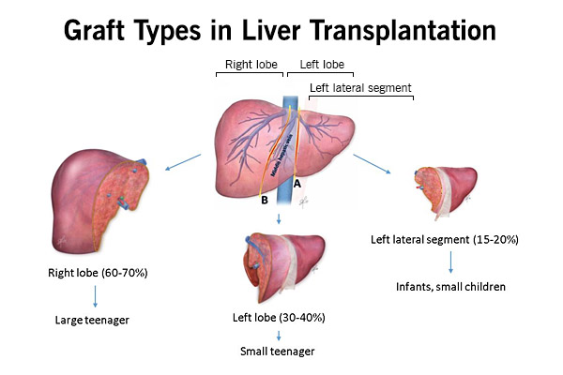

Slide 54
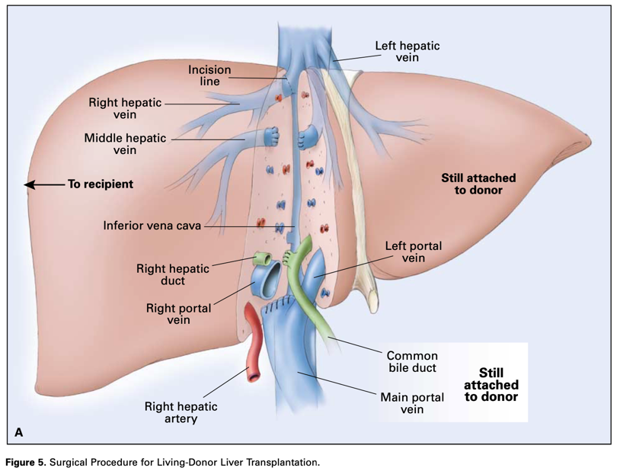
N Engl J Med. 2002 Apr 4;346(14):1074-82

Slide 55
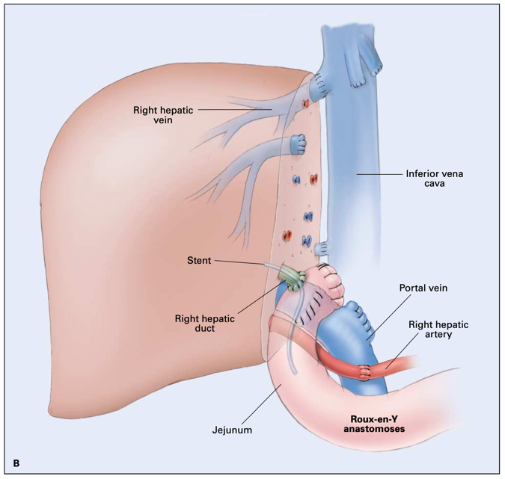
N Engl J Med. 2002 Apr 4;346(14):1074-82

Slide 56
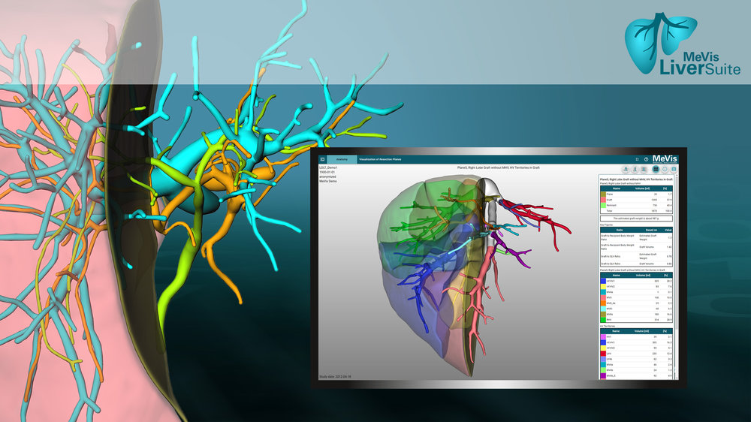
MeVis Liver Suite

Slide 57
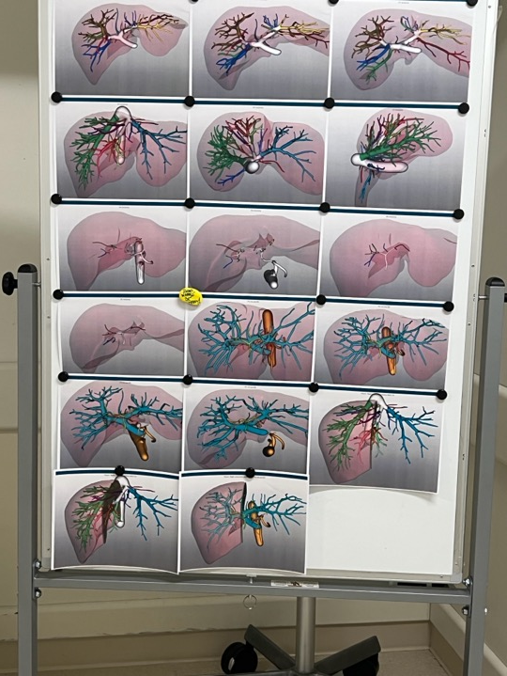

Slide 58
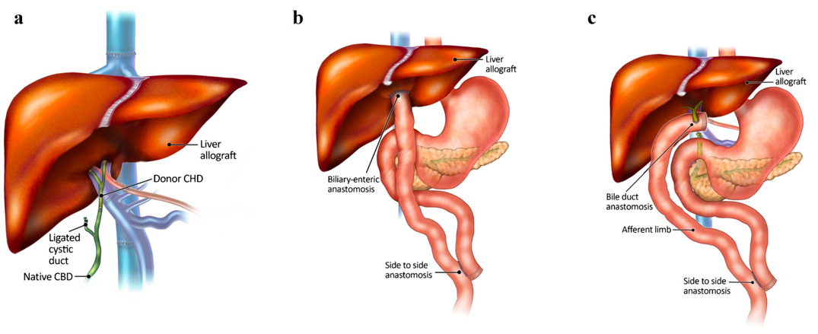
Post Transplant Anatomy
Pediatr Radiol. 2022 Mar;52(3):570-586

Slide 59
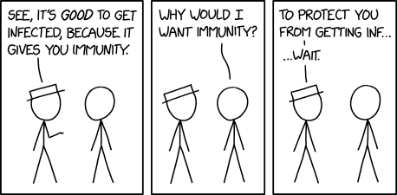
Transplant Immunology 101

Slide 60

Front Immunol. 2020 Sep 2;11:2155

Slide 61

Immunotherapy 2012 4(8), 793–805.

Slide 62



Slide 63


Slide 64
Case Presentation

Slide 65

Case
A 50-year-old patient with a history of autoimmune hepatitis status-post liver transplantation approximately four months ago demonstrated the laboratory results in the table below after reporting fatigue and abdominal pain. A liver ultrasound shows patent hepatic vasculature, no thrombus formation, and no biliary strictures.

Slide 66


Slide 67


Slide 68


Slide 69
Rejection

Slide 70
Liver Transplant Rejection
Acute cellular rejection
Acute antibody-mediated rejection
Chronic rejection

Slide 71

Acute Cellular Rejection
Called T cell-mediated rejection CMR as well
Involves T lymphocytes reacting to the antigenic areas of the graft
Characteristic findings are endothelitis and ductulitis
Lu, Ling, et al. ‘Immunology of Liver Transplantation’. Liver Transplantation - Basic Issues, InTech, 15 Feb. 2012

Slide 72

Thomson M, Lake JR. CAQ Corner: Immune-mediated complications. Liver Transpl. 2022 Jun 24

Slide 73

Gastroenterol Clin N Am 40 (2011) 659–681

Slide 74
Quiz
A 65-year-old man with history of PSC-related cirrhosis complicated by ascites s/p DDLTx from a DCD ~8 months ago, noted for prolonged cold ischemia time, now presenting with asymptomatic elevation in liver enzymes.
  AST 56
  ALT 43
  ALP 342 (Previously, liver enzymes were normal)
  Tbili 3.6
  Dbili 2.8
What is the next step in management?
  Liver biopsy
  MRI/MRCP
  ERCP
  PTC
  RUQ US
  Increase immunosuppression

Slide 75
Post Liver Transplant Biliary Complications
Early on
  Bile leak
  Size mismatch
  Anastomotic stricture (edema)
Later
  Ischemic cholangiopathy
  Recurrent PSC (if original disease)
    De novo PSC! Can happen…
  Anastomotic stricture (true stricture)

Slide 76
Why does ischemic cholangiopathy happen?

Slide 77

Am J Transplant. 2013 Feb;13(2):253-65

Slide 78
Biliary Complications
MRI/MRCP may have reduced sensitivity due to the “rigidity” of the biliary tree of a liver graft
ERCP +/- liver biopsy as a first step is sometimes acceptable (even with a normal MRCP)
MRCP remains the initial diagnostic test of choice (for exam purposes and guideline purposes)

Slide 79


Gastrointest Endosc. 2023 Apr;97(4):607-614

Slide 80
Long-term Complications

Slide 81

Tincopa M. CAQ Corner: Long-term medical complications of liver transplantation. Liver Transpl. 2022;00:1–7

Slide 82

Issa DH, Alkhouri N. Long-term management of liver transplant recipients: A review for the internist. Cleve Clin J Med. 2015 Jun;82(6):361-72

Slide 83

Tincopa M. CAQ Corner: Long-term medical complications of liver transplantation. Liver Transpl. 2022;00:1–7

Slide 84
Take-home Points
Liver transplant is worth it! (75%+ surv. 5y regardless of MELD)
Refer any decompensated or MELD>15 (or LESS? 13?)
  Don’t forget liver donor for low MELDers and Exception points
Last drink being one day ago, does not preclude transplant.
If the transplant thought comes to your mind… just refer!
Don’t let tacrolimus scare you (especially 10-20 years post txp)
“Elevated LFTs” in post Txp = rejection until proven otherwise
Biliary strictures are common! ERCP+/-Bx but get MRCP anyways
Metabolic syndrome and CKD are major problems long term immunosuppression

Slide 85






Slide 86

Thank you
Questions?

